Slide 1



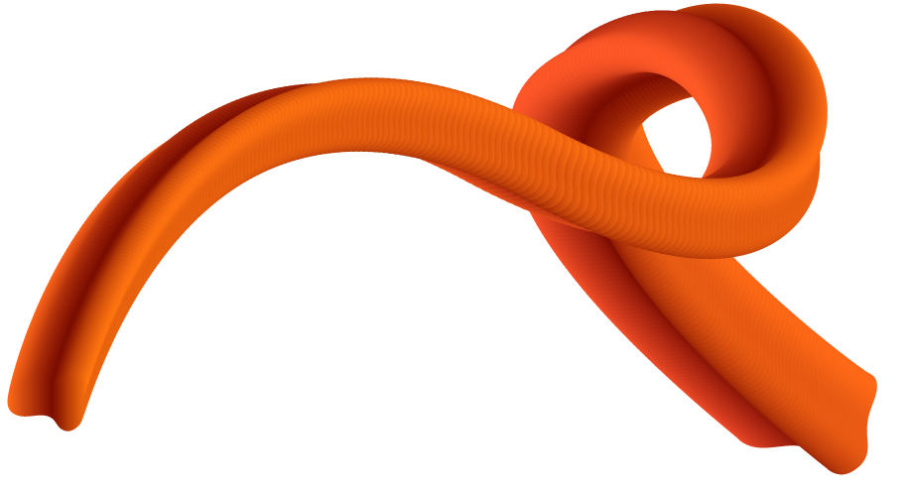
CSS
(Cascading Style Sheet)
Part 3

Slide 2
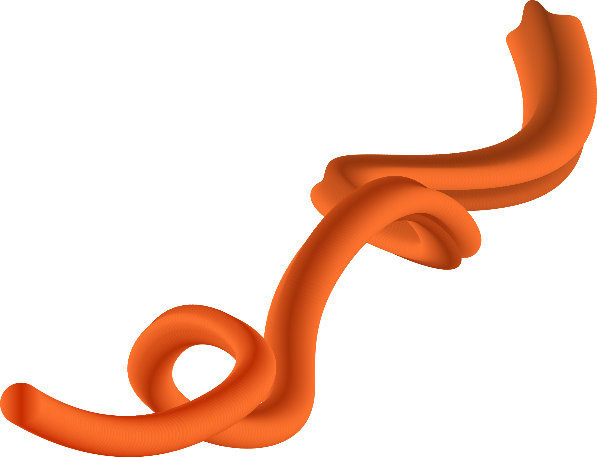
Knowledge Check

Slide 3

Topics
1.
Grid
2.
Border
3.
Bootstrap
4.
5.

Slide 4
01.
Grid
Two dimensional layout

Slide 5
Parent Container
display: grid
grid-template-columns: ...;
grid-template-rows: ... ;
column-gap: <line-size>;
row-gap: <line-size>;
gap: <grid-row-gap> <grid-column-gap>;

Slide 6
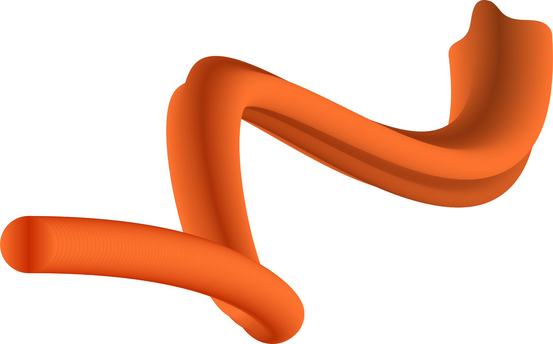

Parent Container (Continue)
grid-auto-columns: <track-size> ...;
grid-auto-rows: <track-size> ...;
grid-auto-flow: row | column

Slide 7
Child Container
grid-column-start: <number> | <name> | auto;
grid-column-end: <number> | <name> | auto;
grid-row-start: <number> | <name> | auto;
grid-row-end: <number> | <name> | auto;
grid-column: grid-column-start + grid-column-end
grid-row: grid-row-start + grid-row-end

Slide 8
Chile Container (Continue)
grid-area: grid-row-start/ grid-column-start/ grid-row-end/ grid-column-end;
justify-self: start | end | center | stretch;
align-self: start | end | center | stretch;

Slide 9

02.
Border

Slide 10
Syntax
border: [border-width] [border-style] [border-color];
border-radius: [border-radius];

Slide 11
Border style
solid, dotted, dashed, double, …
Different border for each side
border-top-style: dotted;
border-right-style: solid;
border-bottom-style: dotted;
border-left-style: solid;

Slide 12
Border radius
Different border-radius for each side
border-top-left-radius: 10px;
border-top-right-radius: 10px;
border-top-bottom-radius: 10px;
border-top-bottom-radius: 10px;

Slide 13
03.
Bootstrap

Slide 14
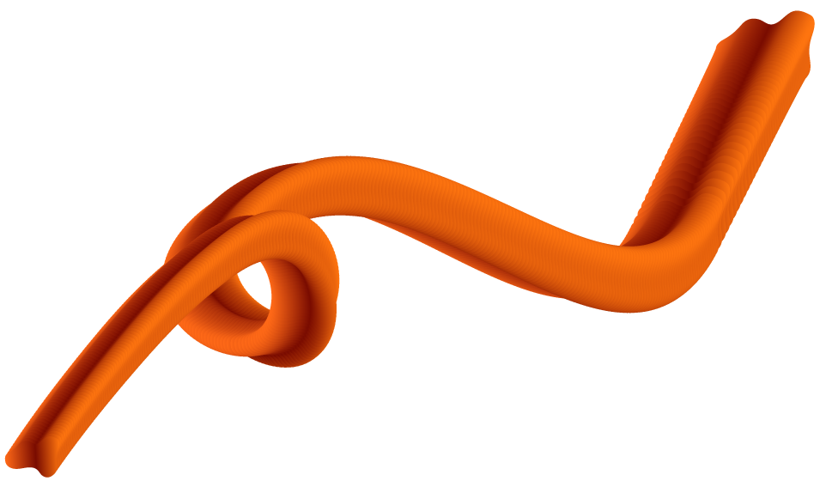

Research resources
https://getbootstrap.com/

Slide 15
Links
CSS
JavaScript
Icons

Slide 16

Topics
Container
Text Formatting
Images
Buttons
Icons

Slide 17
Spacing
Margin:
m: Adds margin to all sides
my: Adds margin top and bottom.
mx: Adds margin to the left and right sides.
mt, mb, ml, mr: Adds margin to the top, bottom, left, or right, respectively.
Padding:
p: Adds padding to all sides.
py: Adds padding top and bottom.
px: Adds padding to the left and right sides.
pt, pb, pl, pr: Adds padding to the top, bottom, left, or right, respectively.

Slide 18
Thank You

